Slide 2
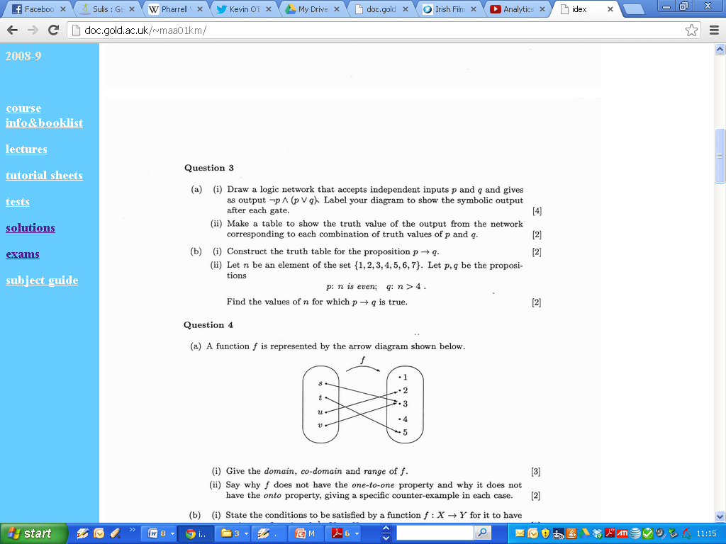
Logic (2001)

Slide 3
Logic (2001)

Slide 4
Logic (2001)

Slide 5
Logic (2001)

Slide 6
Logic (BLANK)

Slide 7
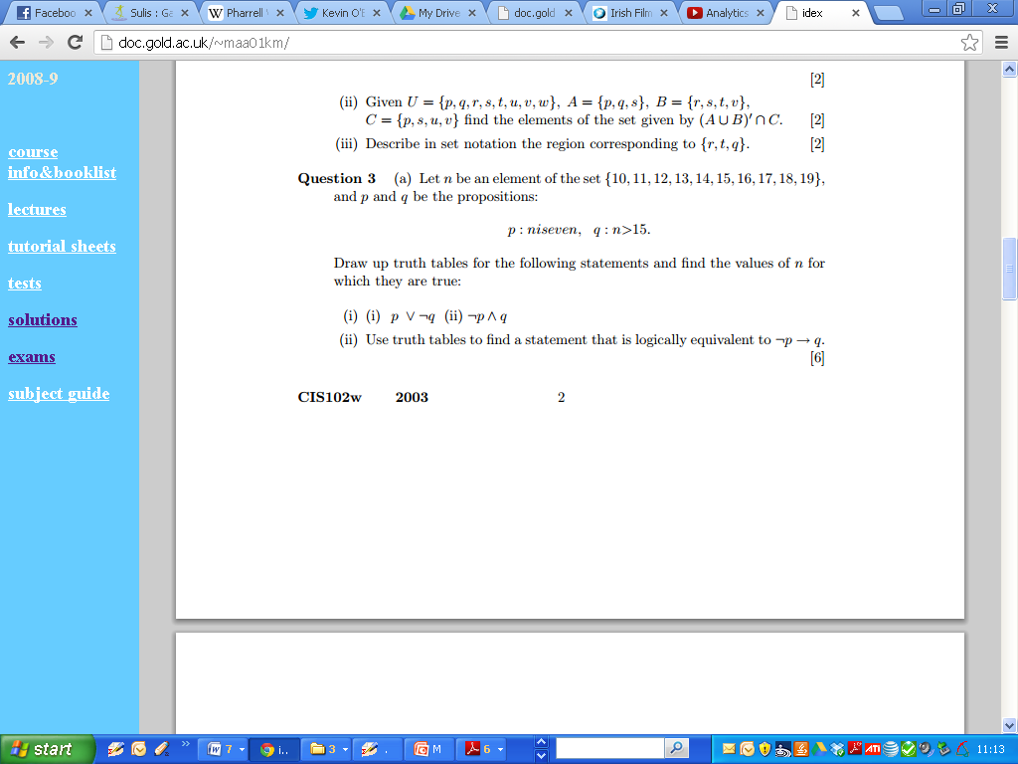
Logic (2003)

Slide 8
Logic (2003)

Slide 9
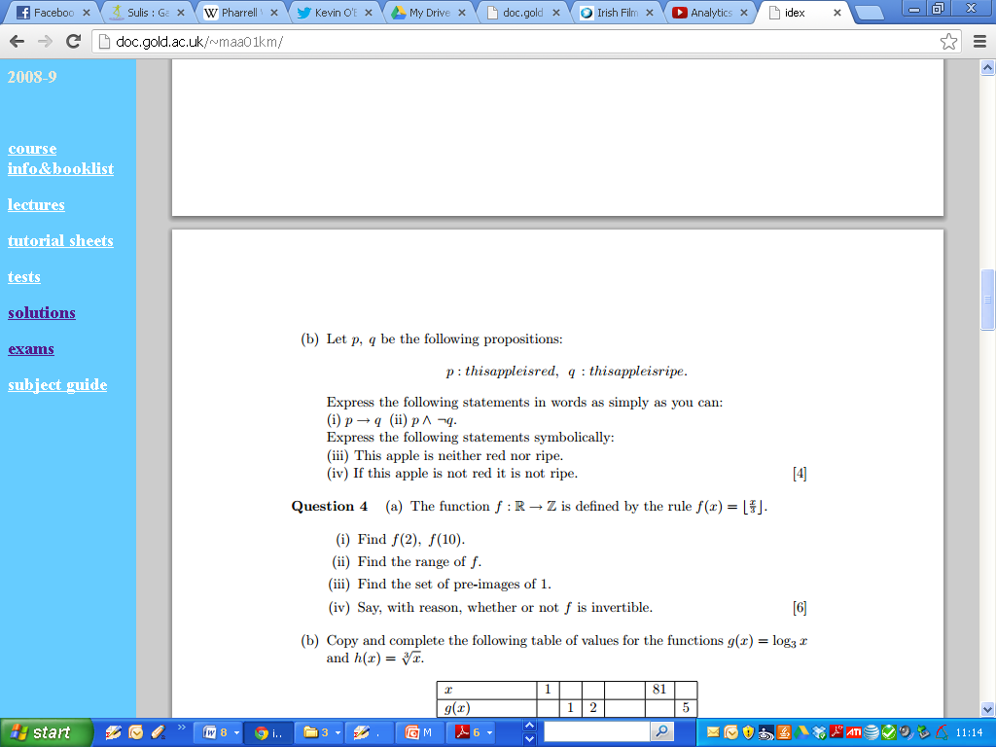
Logic (2003)

Slide 10
Logic (2003)

Slide 11
Logic (BLANK)

Slide 12
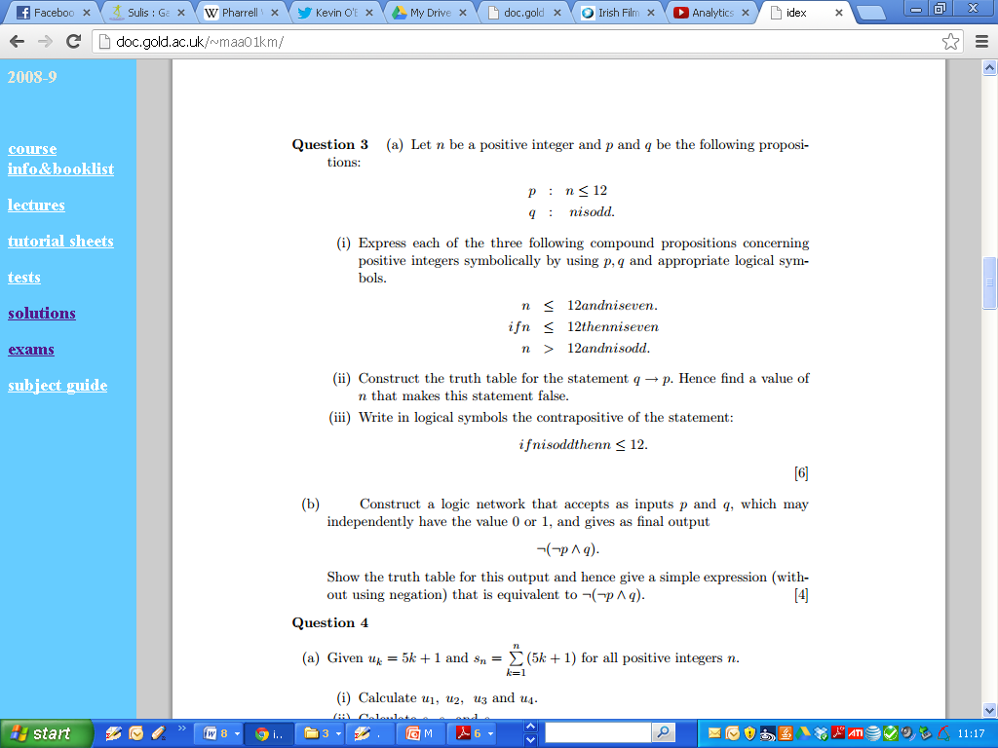
Logic (2007)

Slide 13
Logic (2007)

Slide 14
Logic (BLANK)

Slide 15
Logic (2007)

Slide 16
Logic (2007)

Slide 17
Logic (2007)

Slide 18
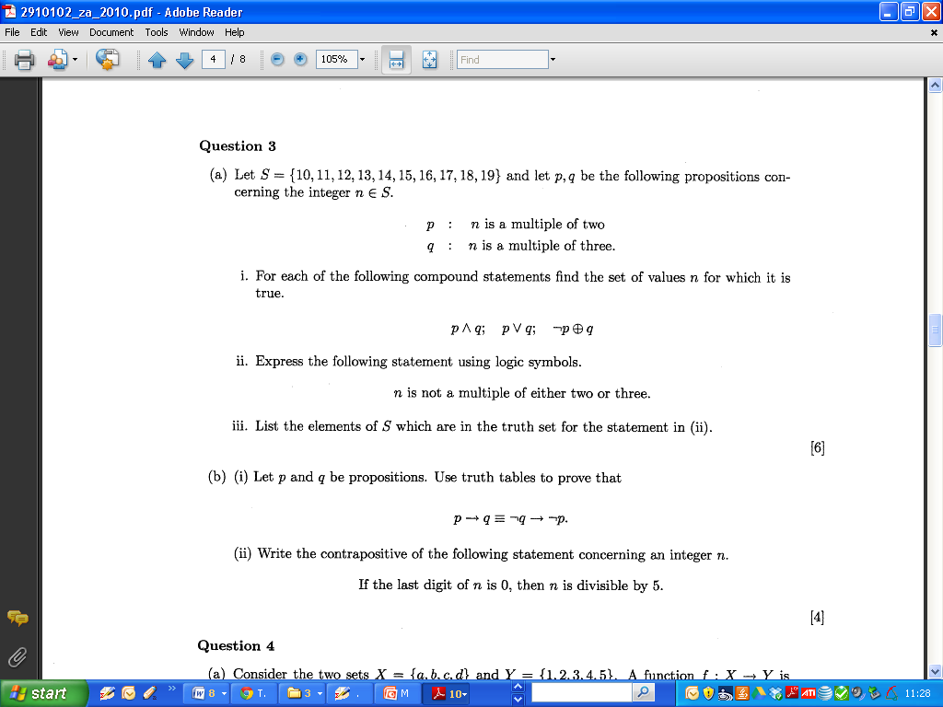
Logic (20XX)

Slide 19
Logic (20XX)

Slide 20
Logic (20XX)

Slide 21
Logic (20XX)

Slide 22
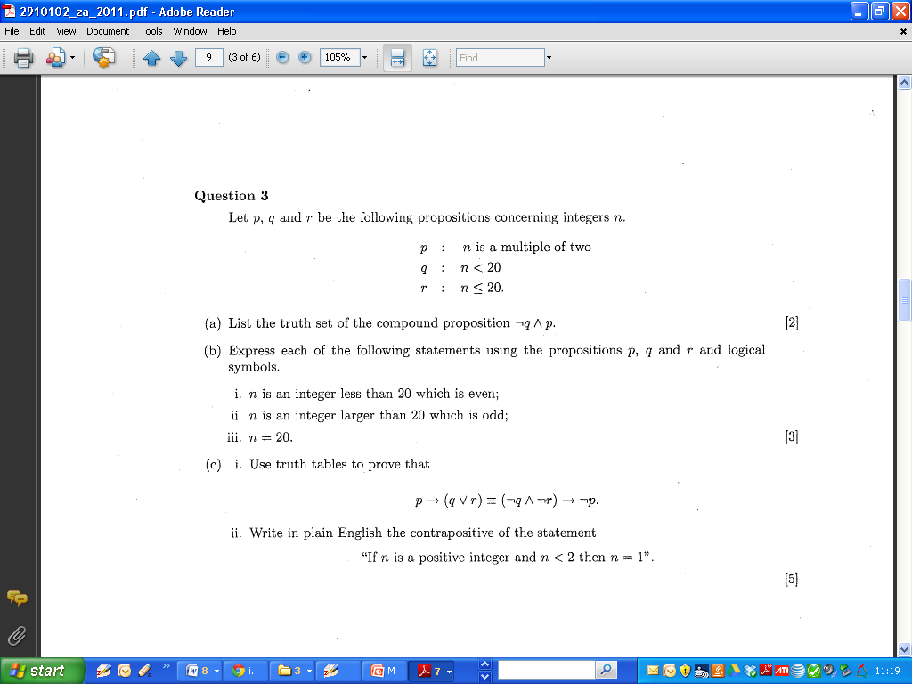
Logic (20YY)

Slide 23
Logic (20YY)

Slide 24
Logic (20YY)

Slide 25
Logic (BLANK)

